Slide 1

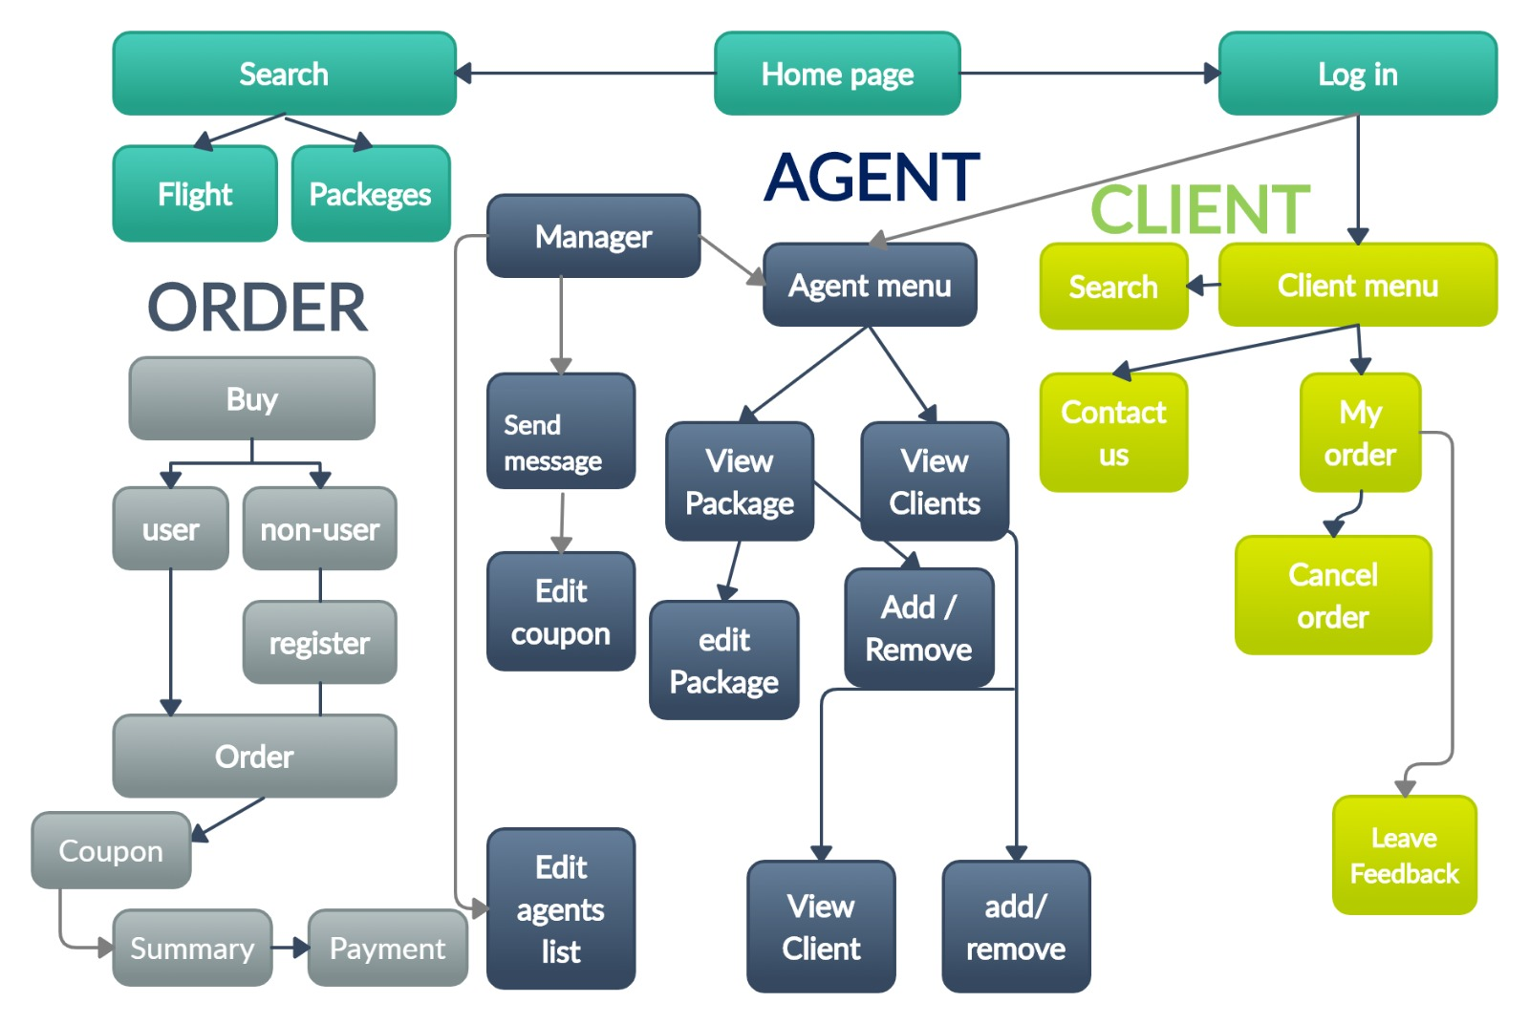
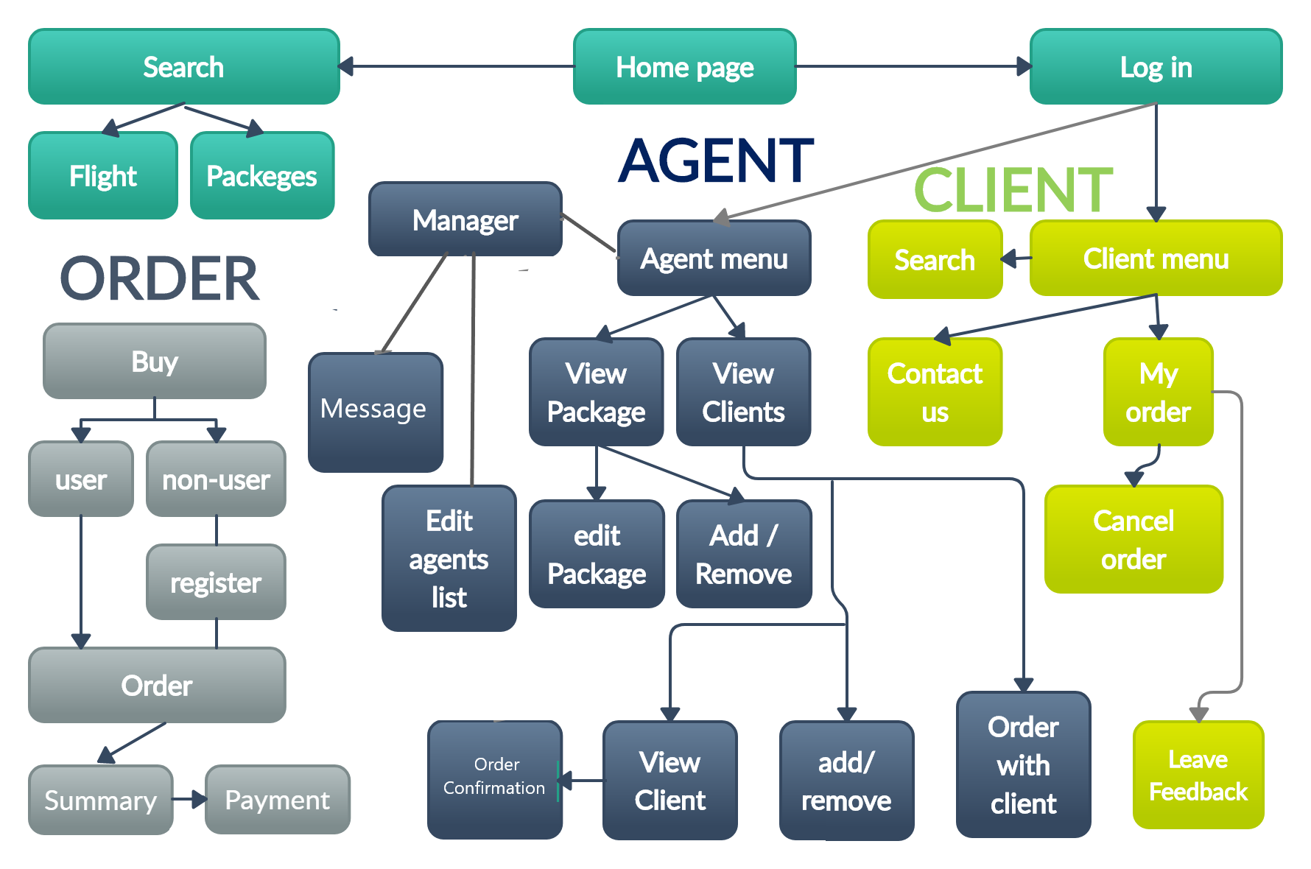
PACK4U
Travel Agency
The purpose of this project is to provide the company a organizational ability and efficient way to manage the company transactions, by developing a user-friendly booking management system.
We present you a prototype of our system.
RESPONSIVE MAP
Visit site

Slide 2

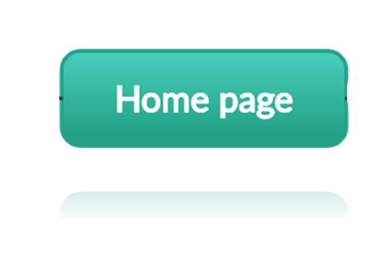
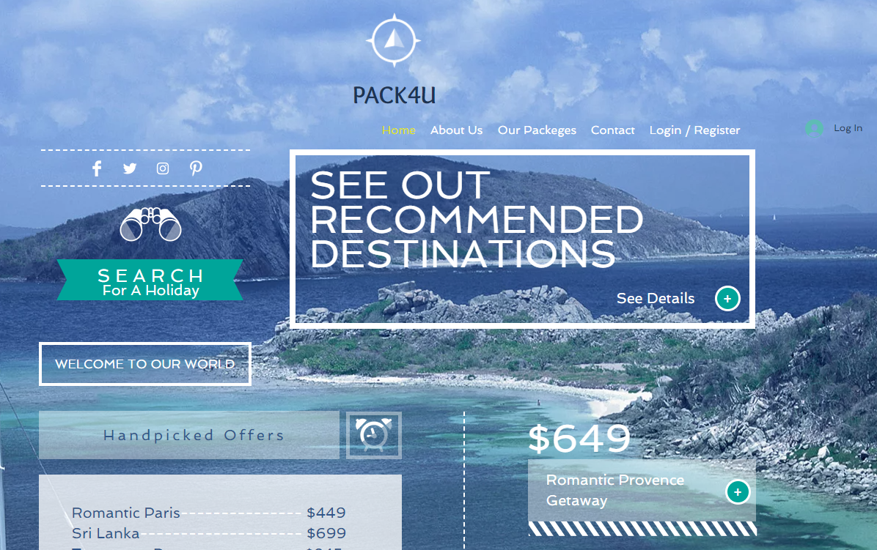
HOME PAGE
Visit site
Back to map

Slide 3
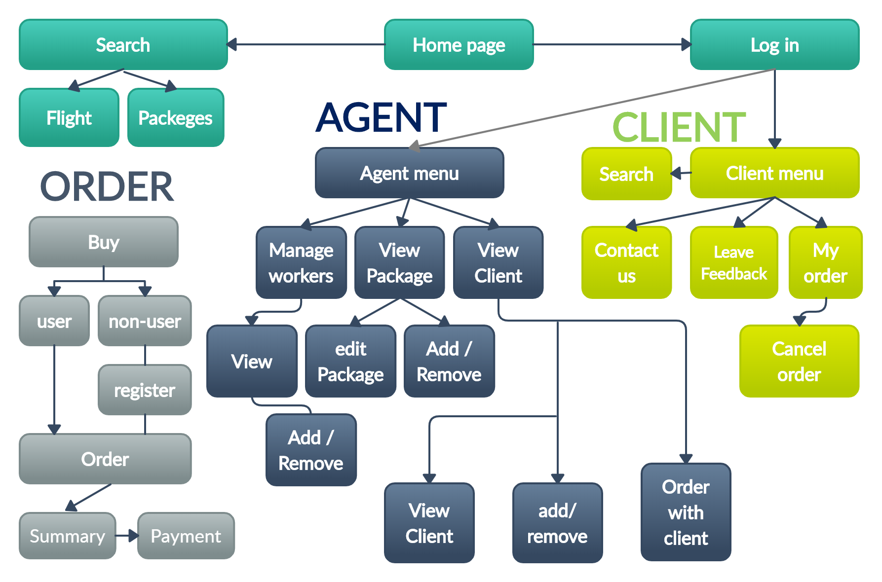
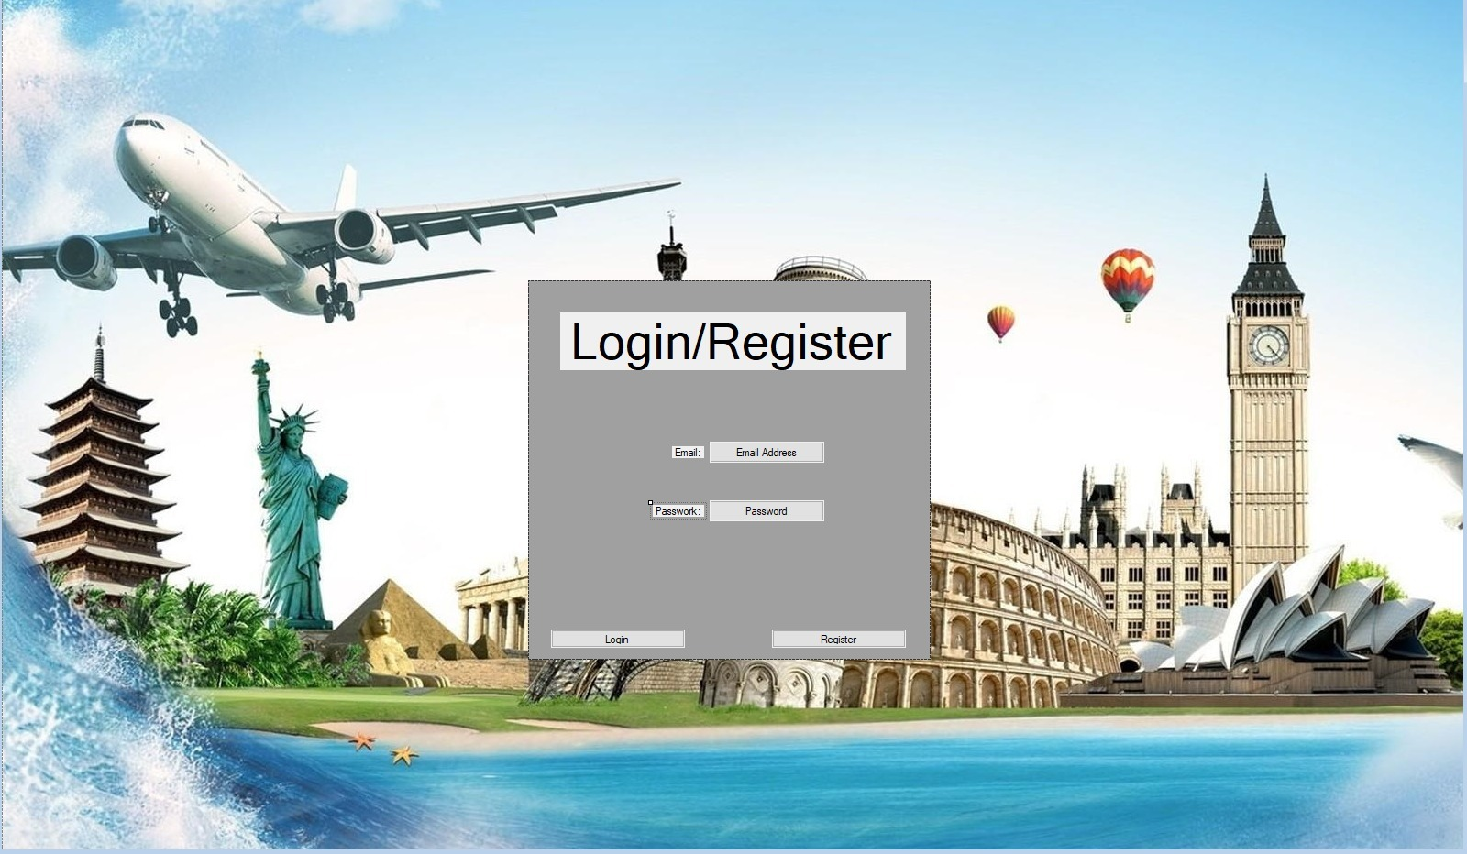
LOGIN /REGISTER
Login/register window.
ID:
PASSWORD:
Visit site
Back to map

Slide 4
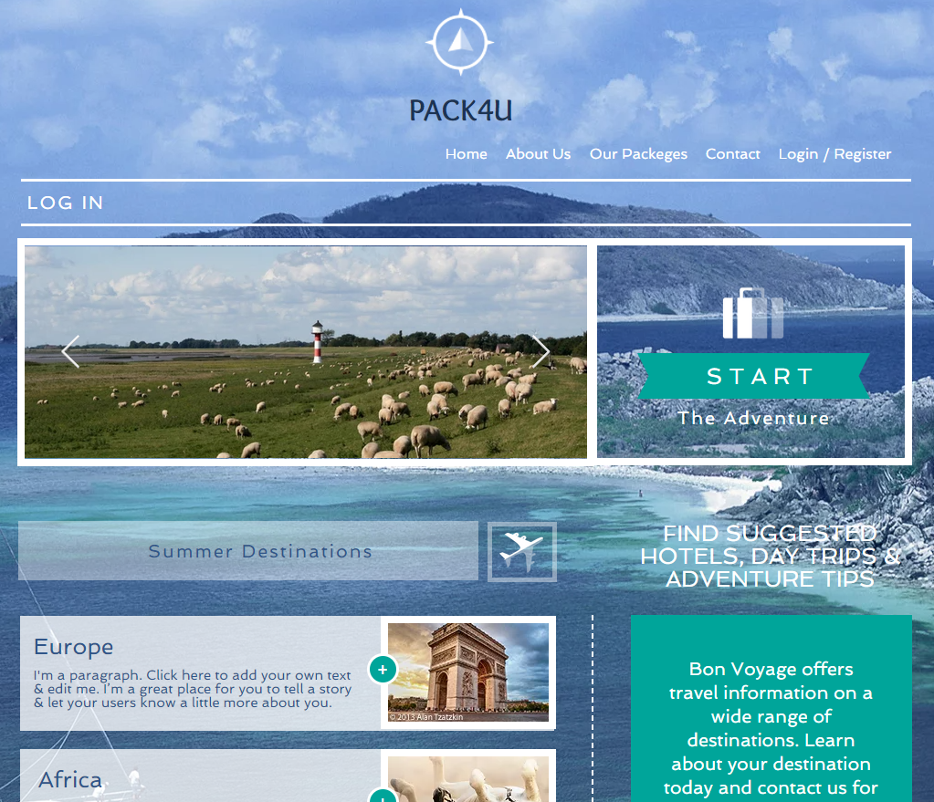
Search
-here the client can find packages and flights, by categories.
View site
Back to map

Slide 5
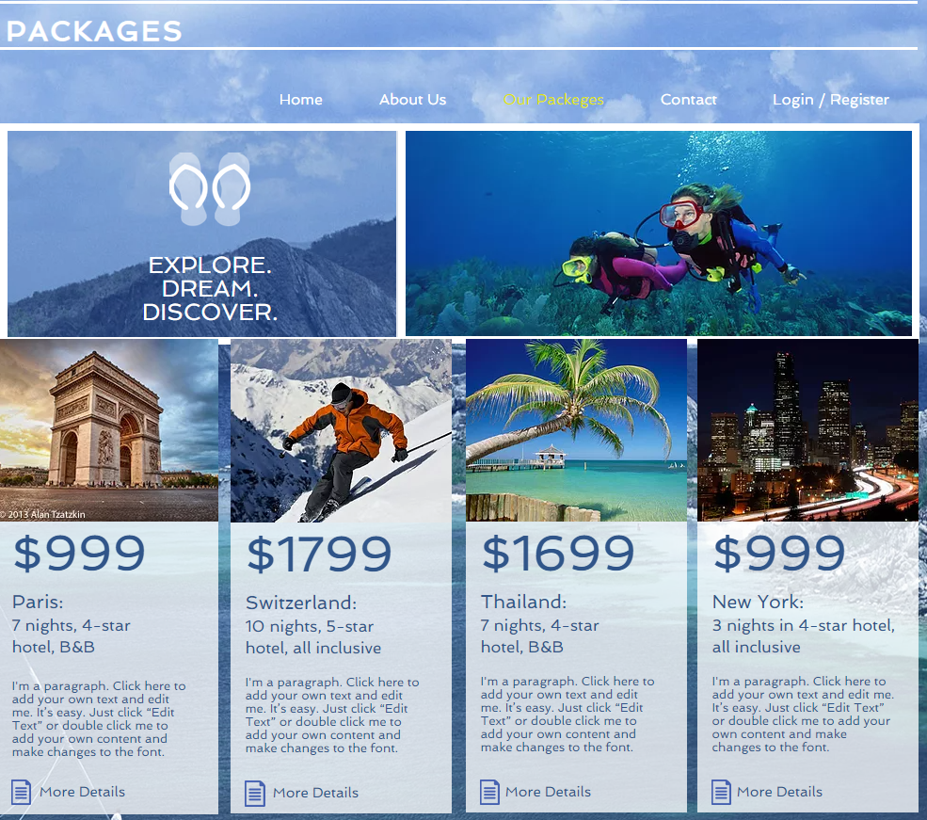
Packages
There is option to search for packages by
destination, price range, date, popularity.
View site
Back to map

Slide 6
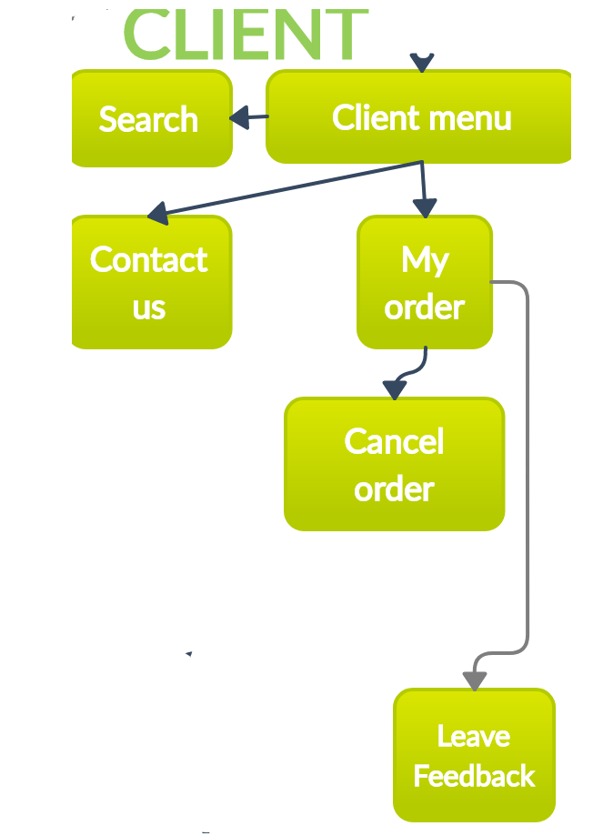
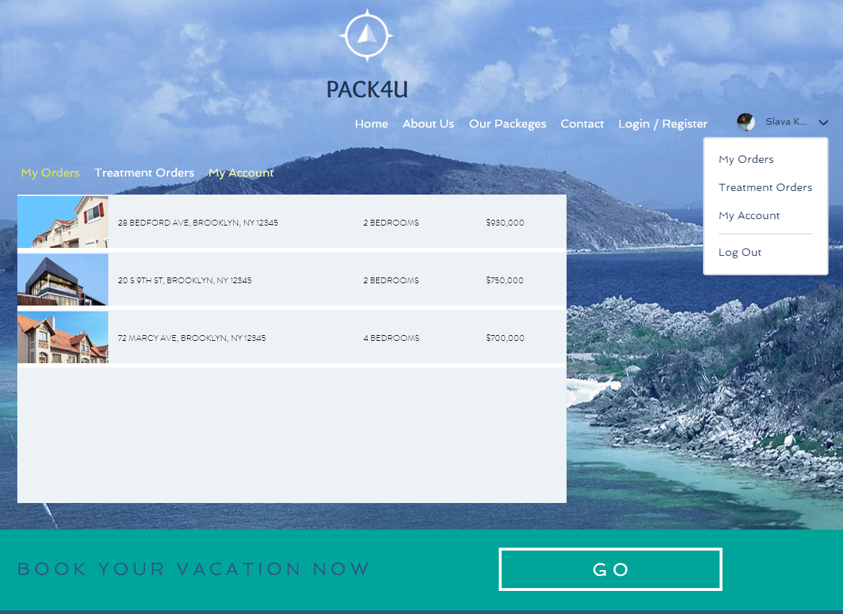
CLIENT MENU
View site
Back to map

Slide 7
MESSAGE BOX
Message
box
-Here the client can check his message box
View site
Back to map

Slide 8
SEARCH
-here the client can view recommended and discounted packages.
There is option to search for packages by
destination, price range, date.
View site
Back to map

Slide 9
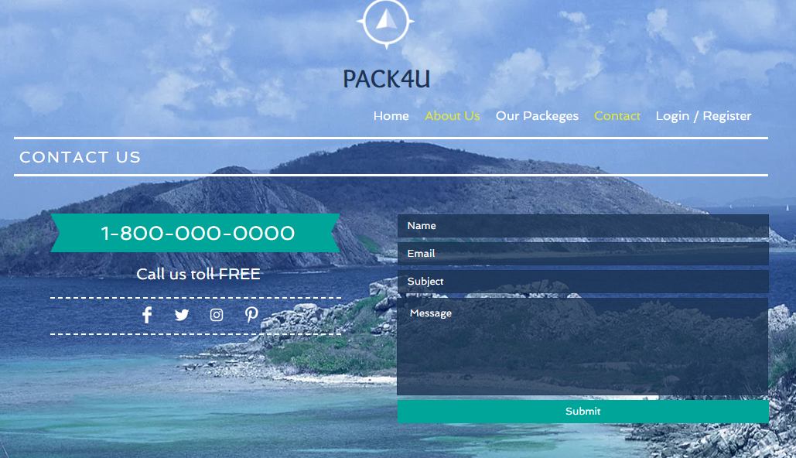
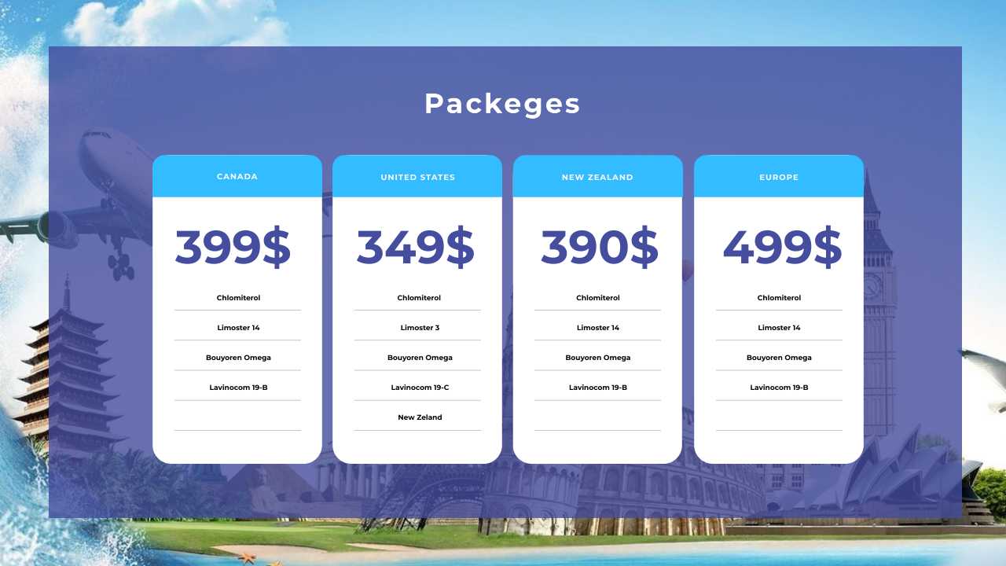
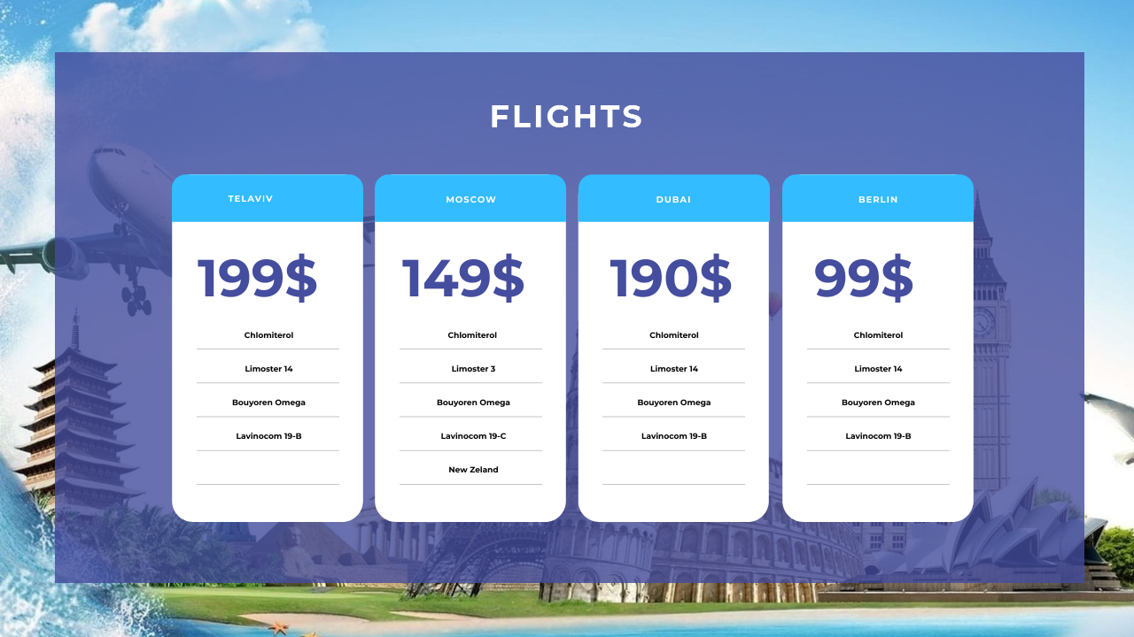
CONTACT US
View site
Back to map

Slide 10
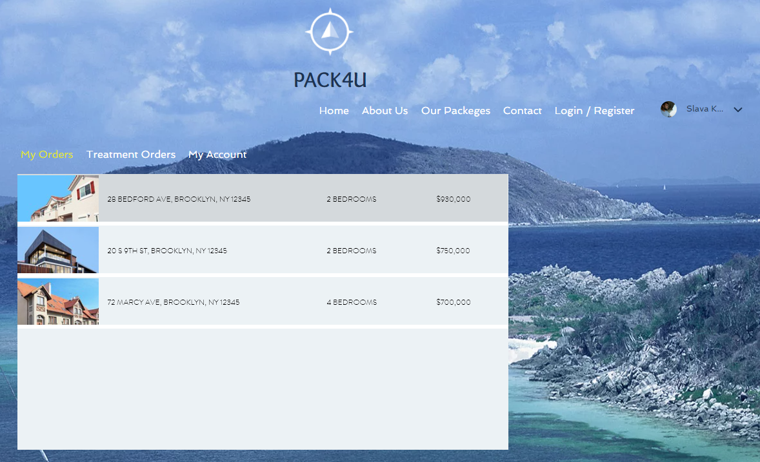
MY ORDERS
-Here the client can manage his orders
View site
Back to map

Slide 11
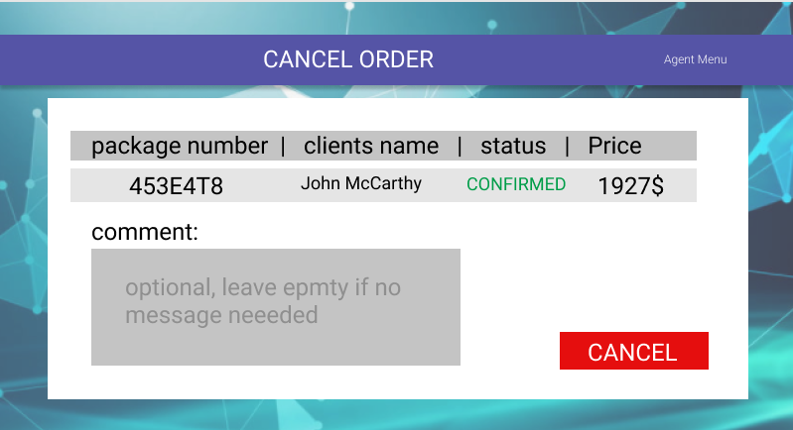
CANCEL ORDER
-The client can cancel an order.
View site
Back to map

Slide 12
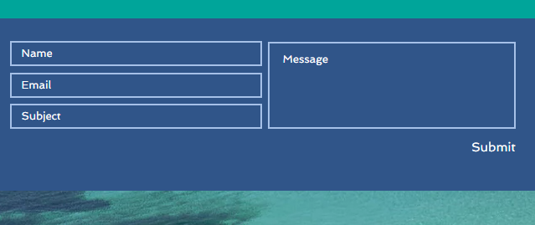
LEAVE A FEEDBACK
Rate this product:
:-The client can rate the product after the package date
View site
Back to map

Slide 13
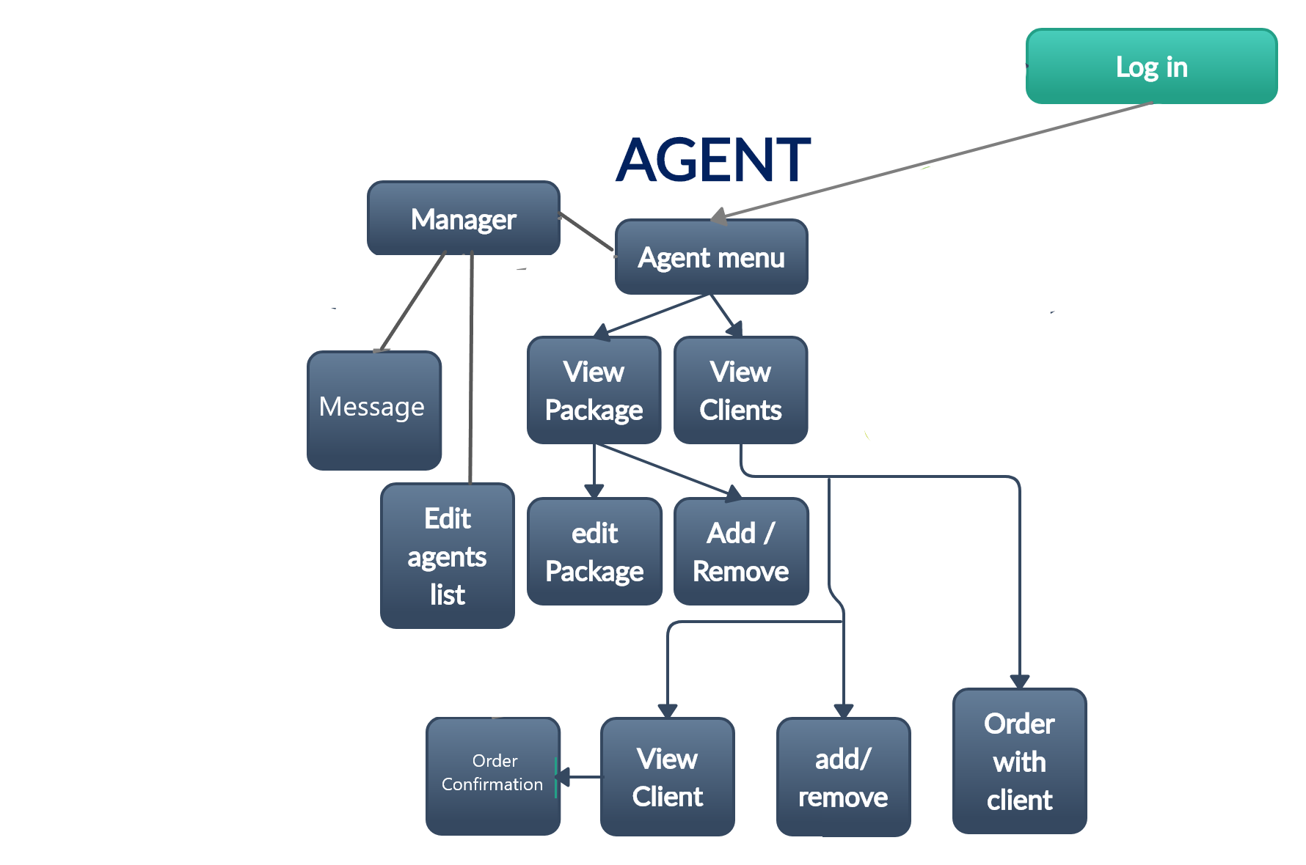
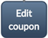
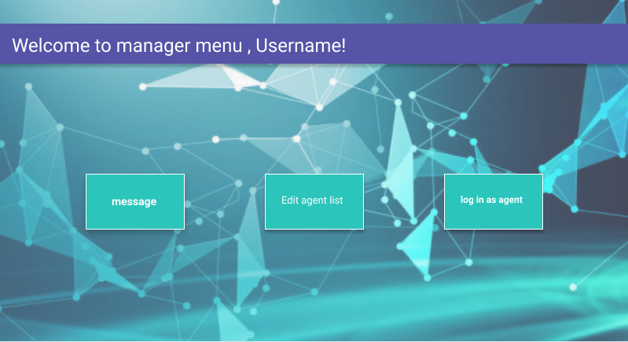
Manager menu
Enter as agent
Visit site

Slide 14
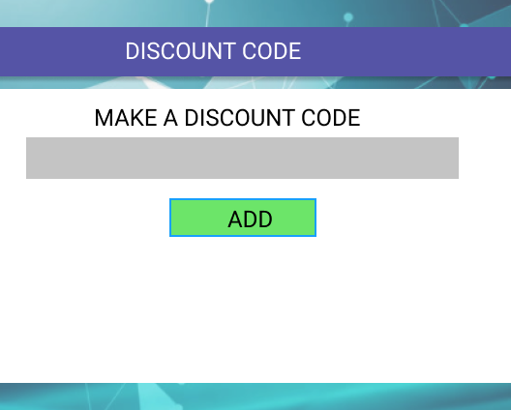
MAKE COUPON
Visit site

Slide 15
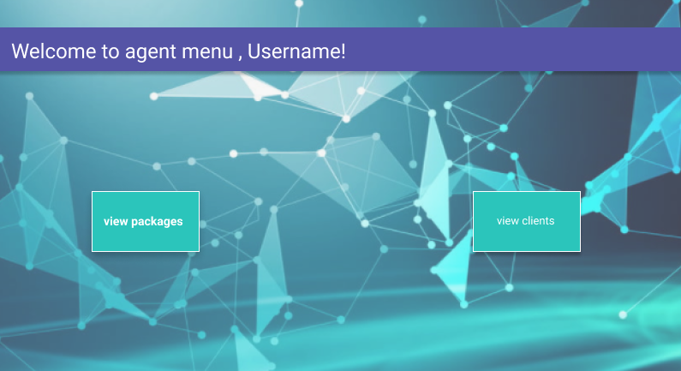
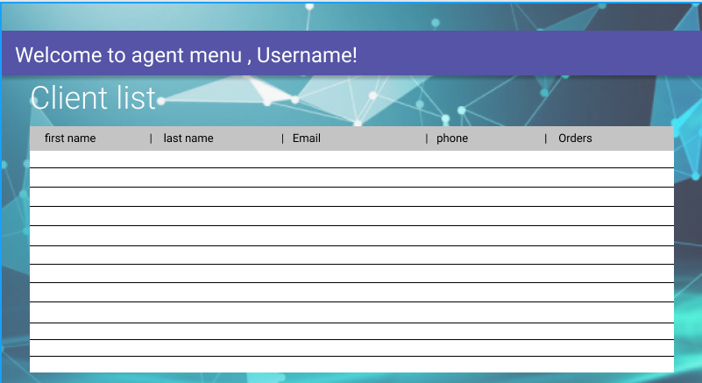
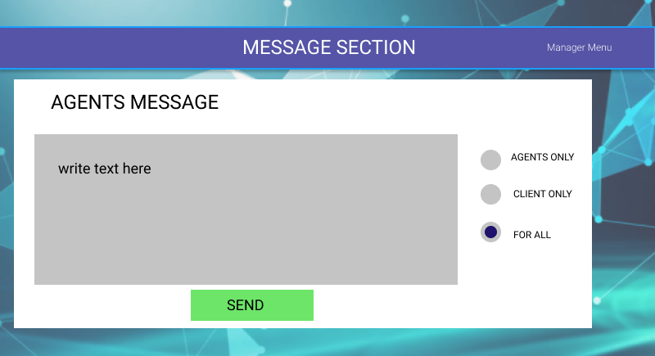
MESSAGE/DISCOUNT
-here manager can send messages, create and send discounts.
Visit site
Back to map

Slide 16

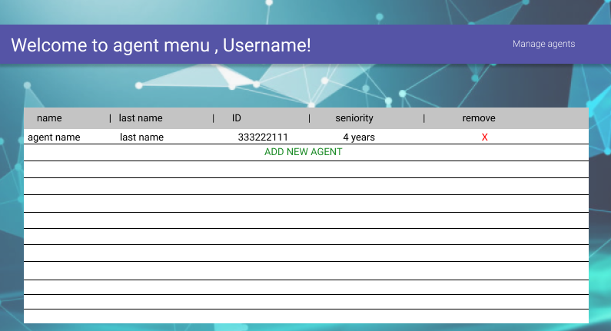
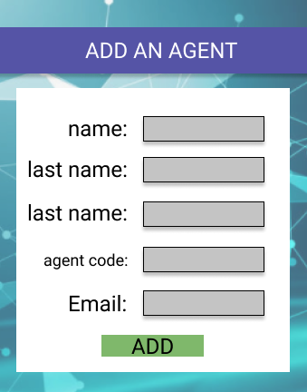
Manager menu
ID:
PASSWORD:
Visit site
Back to map

Slide 17
Agent menu
Visit site
Back to map

Slide 18
Client list
Visit site
Back to map

Slide 19

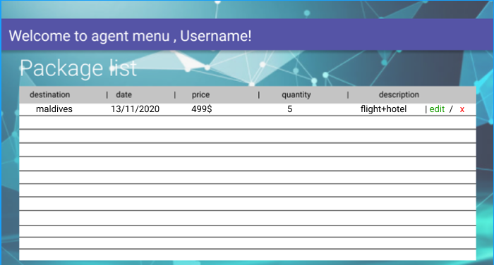
View package
Visit site
Back to map

Slide 20
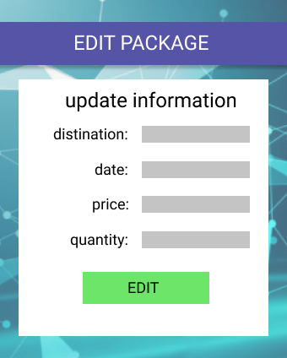
EDIT PACKAGE
-Here the agent can
change and manage packages.
Visit site
Back to map

Slide 21
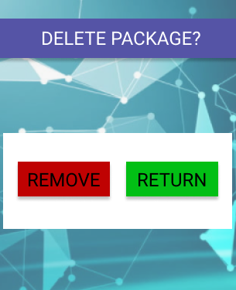
ADD/REMOVEPACKAGE
ID:
Add new
Add new package
ID:
Visit site
Back to map

Slide 22
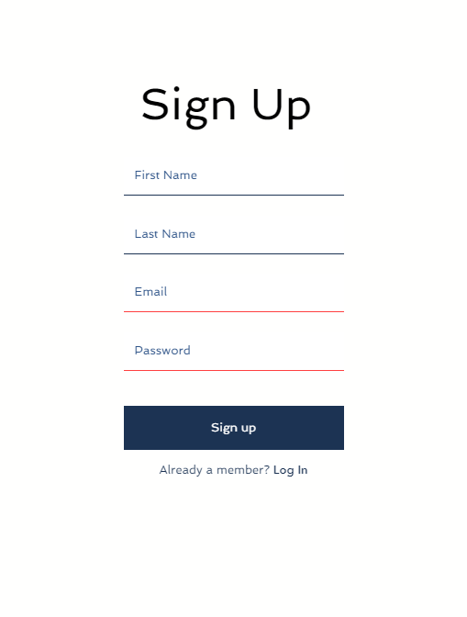
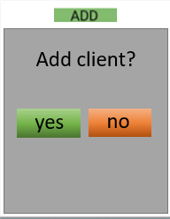

ADD/REMOVE CLIENT
remove
remove
Add client?
Remove client?
yes
no
Visit site
Back to map

Slide 23
Client list
remove
Visit site
Back to map

Slide 24
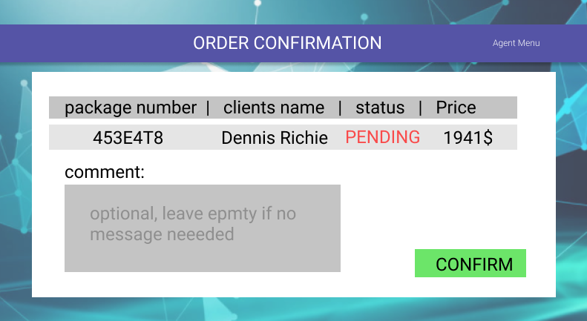
ORDER CONFIRMATION
remove
confirm
-Here agent can confirm orders made by clients
Visit site
Back to map

Slide 25
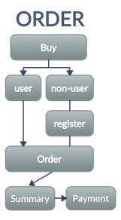
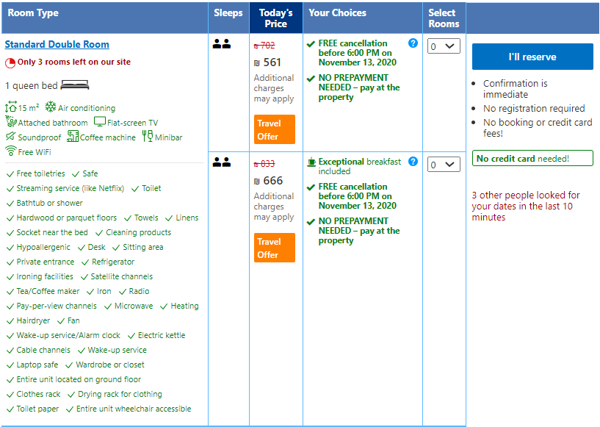

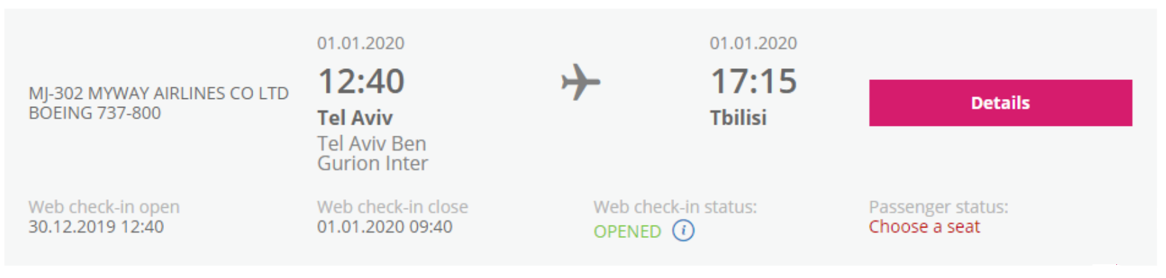
ORDER
Back to map

Slide 26
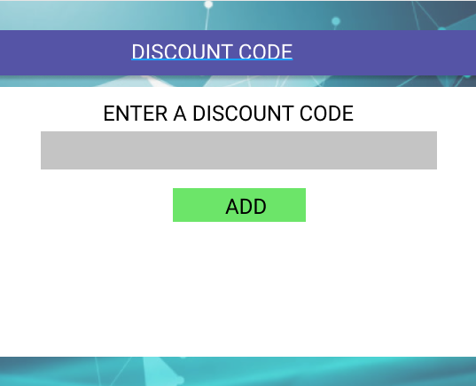
COUPON
In case the clients have coupon code,
they can use it in coupon section to get a discount
Back to map

Slide 27
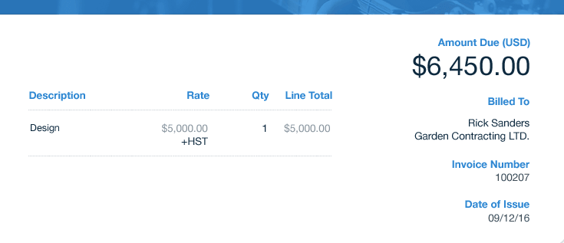

SUMMARY
-here the user can see the final details of the purchase, and use a discount code.
Back to map

Slide 28
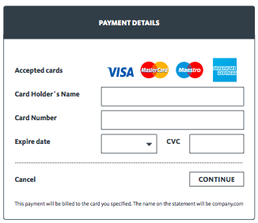
PAYMENT
-Payment section,
If all the information approved , the transaction is completed.
Back to map

Slide 29
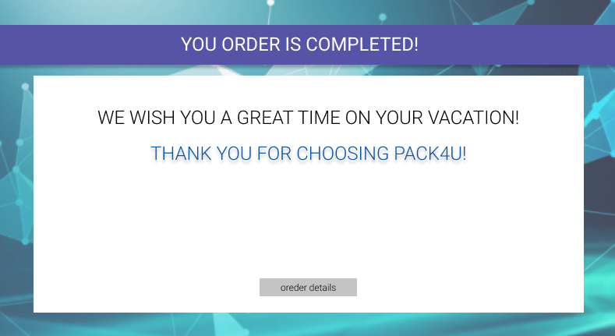
PACK4U
Travel Agency
.
Visit site

